Slide 1
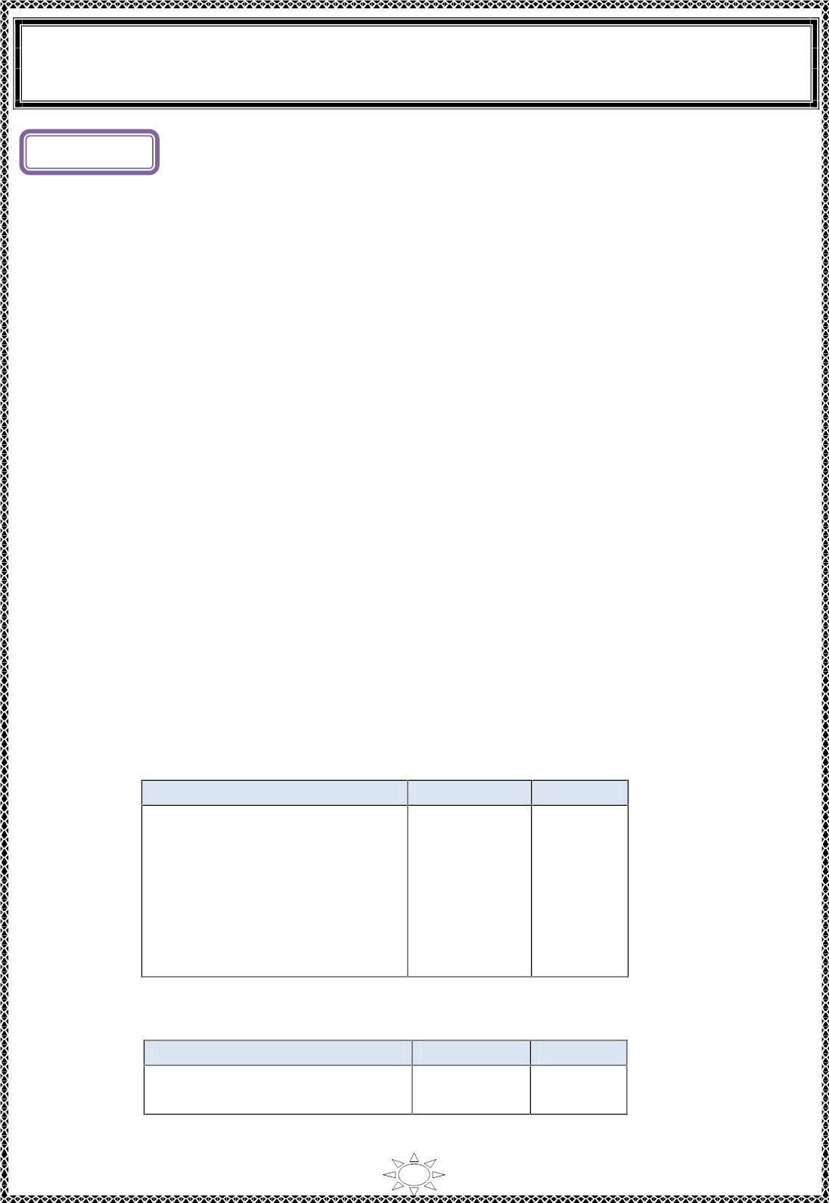
University of Diyala
Engineering College
Electronic Department
Electrical Engineering Fundamentals
1st Class
Asst., Lecturer : Wisam N. AL-Obaidi
Year (2013-2014)
L ectur e (1)
CIRCU IT THEORY
Introduction
Circ uit theory is an important and perhaps the oldest branch of electrical engineering. A
circuit is an interconnection of electrical elements. These include passive elements, such
as resistances, c apac itanc es , and inductances, as well as active elements such as s ourc es.
Two variables, namely voltage and current variab les are associated with each c ircuit
element. There are two aspects to circuit theory: analysis and design. C ircuit analysis
involves the determination of current and vo ltage values in d ifferent elements of the
c irc uit, given the values of the sources. On the other hand, c irc uit design focuses on the
d es ign of circuits that exhib it a certain pres pecif ied vo ltage or current characteristics at
one or more parts of the c irc uit.
System of Units
1) The English system.
2) The metric system whic h is s ubdivided into two interrelated standards:
• The MKS system uses Meters, Kilo gr ams , and Seconds.
• The CGS system us es Centimeters, Grams, and Seconds.
3) The int ernat iona l metric system of units (SI).
Trail Version
Trail Version
Trail Version
Trail Version
Trail Version
Trail Version
Trail Version
Trail Version
Trail Version
Trail Version
Trail Version
Trail Version
Trail Version
The international system of units, c o mmo nly c a lled SI, is used in electr icit y. The seven
base units of SI are listed in Tab le (1.1). The two supplementary units of SI are p lane
angle and solid angle Tab le (1.2).
Tab le (1.1): Base Units of the International Metric System
Length
Mas s
Time
Quantity
Base Un it
meter
Symbol
kilogram
second
ampere
kelvin
m
kg
s
A
K
cd
Elec tr ic current
Thermodynamic temperature
Light intens ity
Amount of substance
candela
mo le
mol
Tab le (1.2): Supplementary SI Units
Quantity
Un it
Symbol
Plane angle
So lid angle
radian
steradian
rad
sr
1

Slide 2
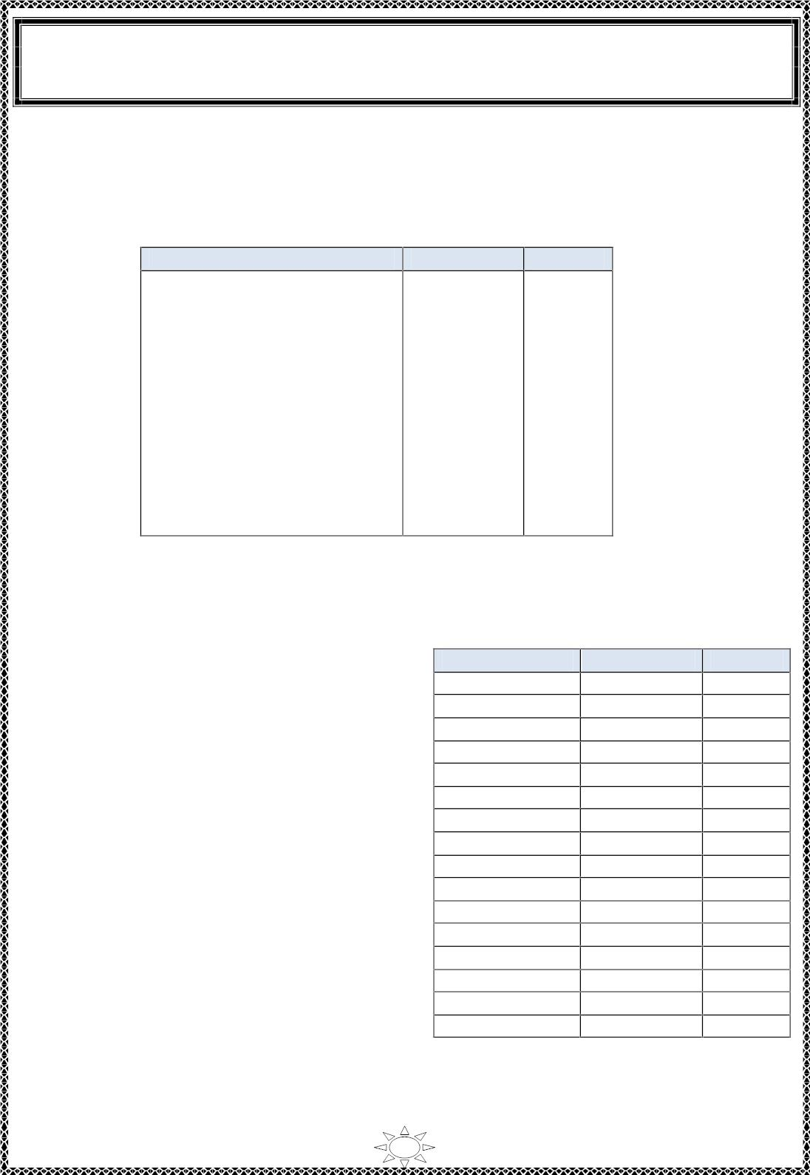
University of Diyala
Engineering College
Electronic Department
Electrical Engineering Fundamentals
1st Class
Asst., Lecturer : Wisam N. AL-Obaidi
Year (2013-2014)
Other common units can be derived from the base and supplementary units. For
examp le, the unit of charge is the coulomb, whic h is derived from the base units of s econd
and ampere. Most of the units that are used in electricit y are derived ones Tab le (1.3).
Table (1.3): Derived SI Units
Quantity
Unit
Symbol
Energy
joule
J
Force
Power
ne wton
watt
coulomb
volt
N
W
C
V
Ω
S
Electric charge
Electric potential
Electric resistance
Electric conductance
Electric capacitance
Electric inductance
Frequency
ohm
siemens
farad
henry
hertz
we ber
tesla
F
H
Hz
wb
T
Magnetic flux
Magnetic flux density
Trail Version
Trail Version
Trail Version
Trail Version
Trail Version
Trail Version
Trail Version
Trail Version
Trail Version
Trail Version
Trail Version
Trail Version
Trail Version
Metric Prefixes
In the study of bas ic electr icit y, some
electrical units are too small or too large to
express conveniently. For example, in the case
of resistance, we often use values in thousands
or millions of ohms (Ω). The prefix k ilo
(denoted by the letter k) is a convenient way of
expressing a thousand. Thus, instead of saying
a resistor has a value of 10 000 Ω, we normally
refer to it as a 10-kilohm (10-kΩ) res istor. In
the case of current, we use expressions such as
milli amperes and microamperes. The pref ix
milli is a short way of saying a thousandth and 10⁻³
micro is a short way of saying a millionth. 10⁻⁶
Thus 0.012 A bec omes 12 milliamperes (mA) 10⁻⁹
and 0.000 005 A becomes 5 microamperes 10⁻¹²
(µA). Tab le (1.4) lists the metric prefixes
c o mmo nly used in electric ity and their
numer ical equivalents.
Tab le (1.4): SI unit prefixes
Multiplier
₁₀18
₁₀15
10¹²
10⁹
10⁶
10³
10²
Prefix
exa
peta
Symbol
E
P
T
G
M
k
h
da
d
tera
giga
mega
kilo
hecto
deka
deci
centi
milli
micro
nano
pico
femto
atto
10
₁₀-1
₁₀-2
c
m
µ
n
p
f
10⁻¹⁵
10⁻¹⁸
a
2

Slide 3
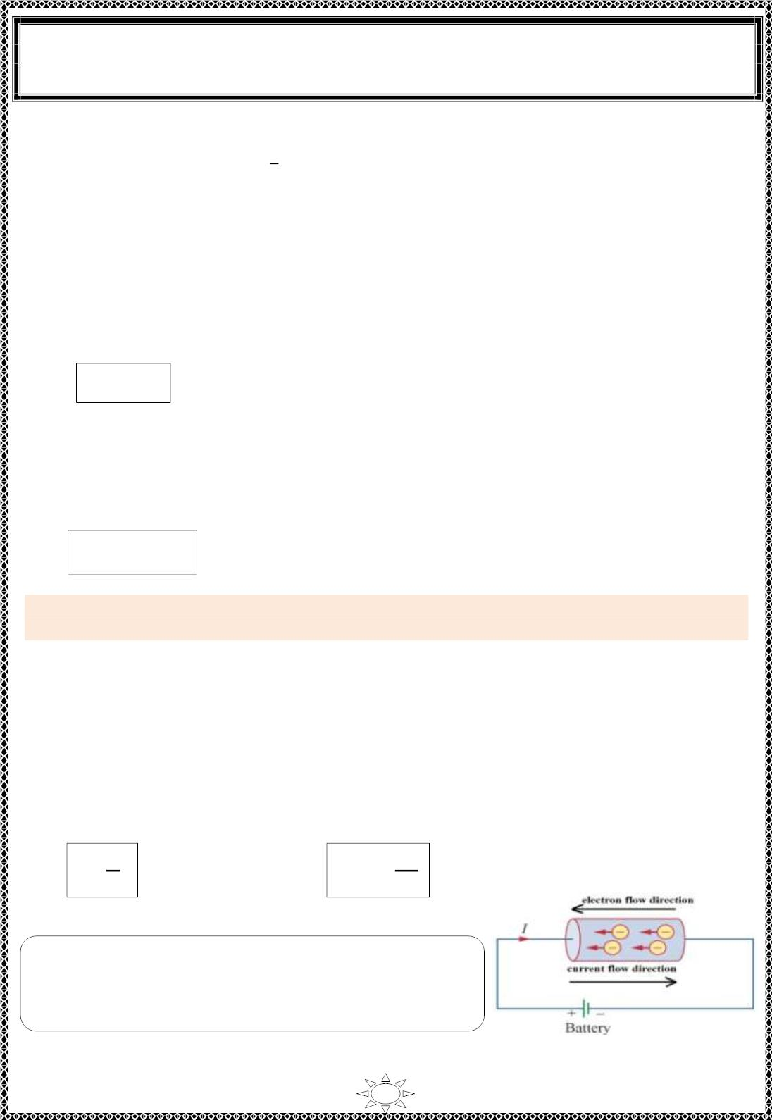
University of Diyala
Engineering College
Electronic Department
Electrical Engineering Fundamentals
1st Class
Asst., Lecturer : Wisam N. AL-Obaidi
Year (2013-2014)
Definitions & Terminologies
1- Electric charge ( Q) : is a physical properity of electrons and protons in the
atoms that gives ris e to force between atoms. The charge is measured in c oulomb
[C].
The coulomb is defined as the quantity of electric ity which flows in an electr ic
circuit when a current of one ampere flow for one second.
The charge of proton is arbitrarily chosen as pos it ive and has the value of
(1.6 × 10-19 C), whereas the charge of an electron is chosen as negative with a value
of (-1.6 ×10⁻¹⁹ C).
Note that, like charges repel while unlike charges attract each other.
Q = I.t
[C]
Where, Q:- electr ic chargein coulomb.
I:- electr ic current in ampere.
t:- t ime in second.
The total charge (Q) transferred during the time from (t ) to (t ) can be calculated as,
1
2
Trail Version
Trail Version
Trail Version
Trail Version
Trail Version
Trail Version
Trail Version
Trail Version
Trail Version
Trail Version
Trail Version
Trail Version
Trail Version
풕
ퟐ
Q= 풊. 풅풕
[C]
풕
ퟏ
Example 1: If a current of 5A f lows for 2 minutes. Find the quantity of electricit y
transferred.
Solution:
Quantity of electr icity is (Q) =I.t
I=5A, t = 2 × 60 = 120 second [S]
Hence Q = 5 × 120 = 600 C
2- Current (I) : is the flow rate of electr ic charge that is measured as coulombs per
second. The unit of electric current is ampere [A].
An ampere is def ined as the flow of charge at the rate of one coulo mb per second
(1A = 1C/S).
퐐
퐝퐪
I =
[A]
or
i(t) =_{퐝퐭}
[A]
퐭
Note: the conventional direction of current flo w is
reverse to the direction of electrons flo w as shown in
Figure (1.1).
Figure (1.1)
3

Slide 4
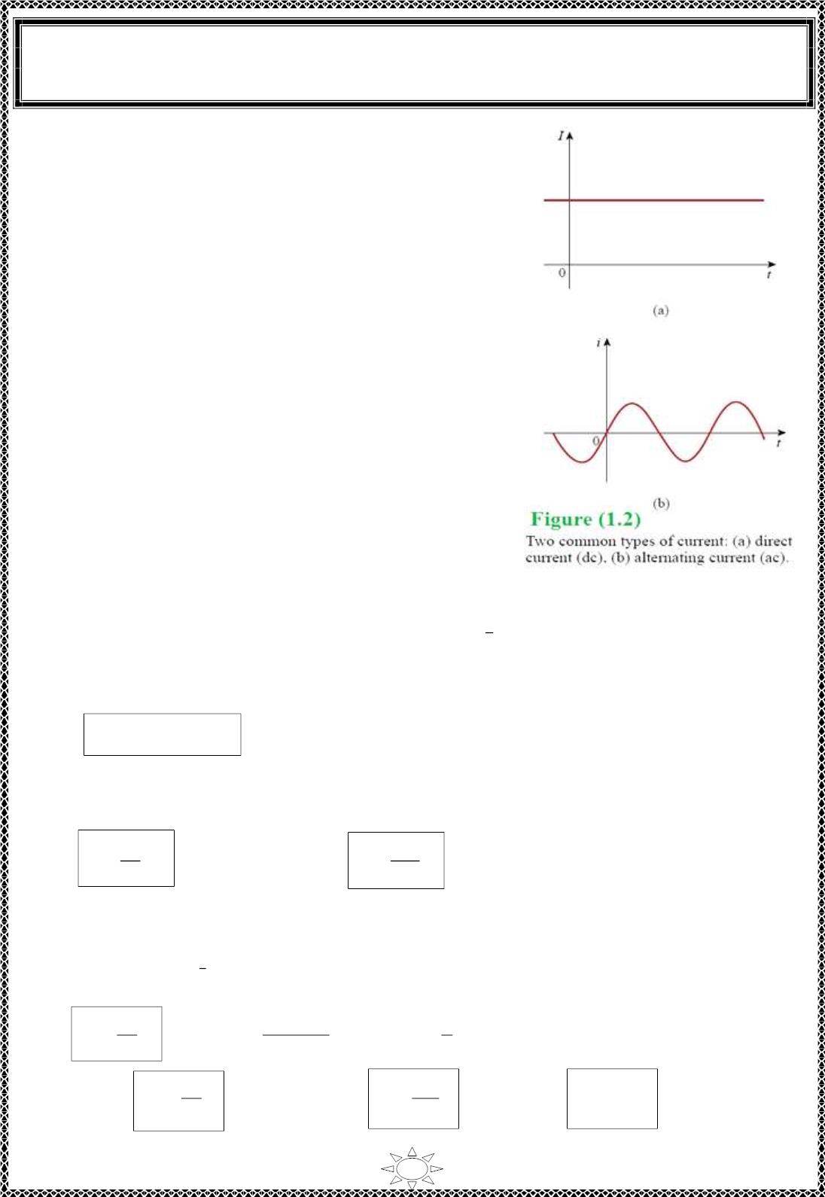
University of Diyala
Engineering College
Electronic Department
Electrical Engineering Fundamentals
1st Class
Asst., Lecturer : Wisam N. AL-Obaidi
Year (2013-2014)
3- Direct current (dc): is the current that remains
cons tant in direction & magnitude (constant with
time) as shown in Figure (1.2)(a).The symbol (I)
is usually used to represent such a constant
current. The reason for such unidirectional current
is that the voltage source ma int a in the same
polar ity for the output voltage.
The voltage supplied by these sources is called
direct current vo ltage or dc voltage.
4- Alternating current (ac): is the current that
reverse or alternates in polarit y with time such
sinusoidal current as shown in Figure (1.2)(b), ac
usually represent by a symbol i or i(t).
Trail Version
Trail Version
Trail Version
Trail Version
Trail Version
Trail Version
Trail Version
Trail Version
Trail Version
Trail Version
Trail Version
Trail Version
Trail Version
5- Voltage or Potential Difference (PD):- potential d ifference (V_{AB}) between
two points A & B, is the amount of energy required (or work done) to move a un it
pos it ive charge from point A to point B. If th is energy is posit ive, then (V_{AB}) is
pos it ive & point A is higher potential with respect to (w.r.t.) point B.
V = V – V
B
& V_{A} > V_{B}
AB
A
The voltage is measured using the unit of vo lt [V], whic h is the work of 1 -joule used
to move a charge of 1-coulombbetween two points.
W
Q
푑푤
푑푞
V =
or
v =
Where, W:- is the energy or work done.
6- Power (P):- it is defined as the rate of work done, or it is the rate of energy wit h
respect to time.
W
t
joule
J
, or W = ]
S
P =
Or
[ watt =
second
W
QV
P =
or
P =
or
P = IV
t
t
4

Slide 5
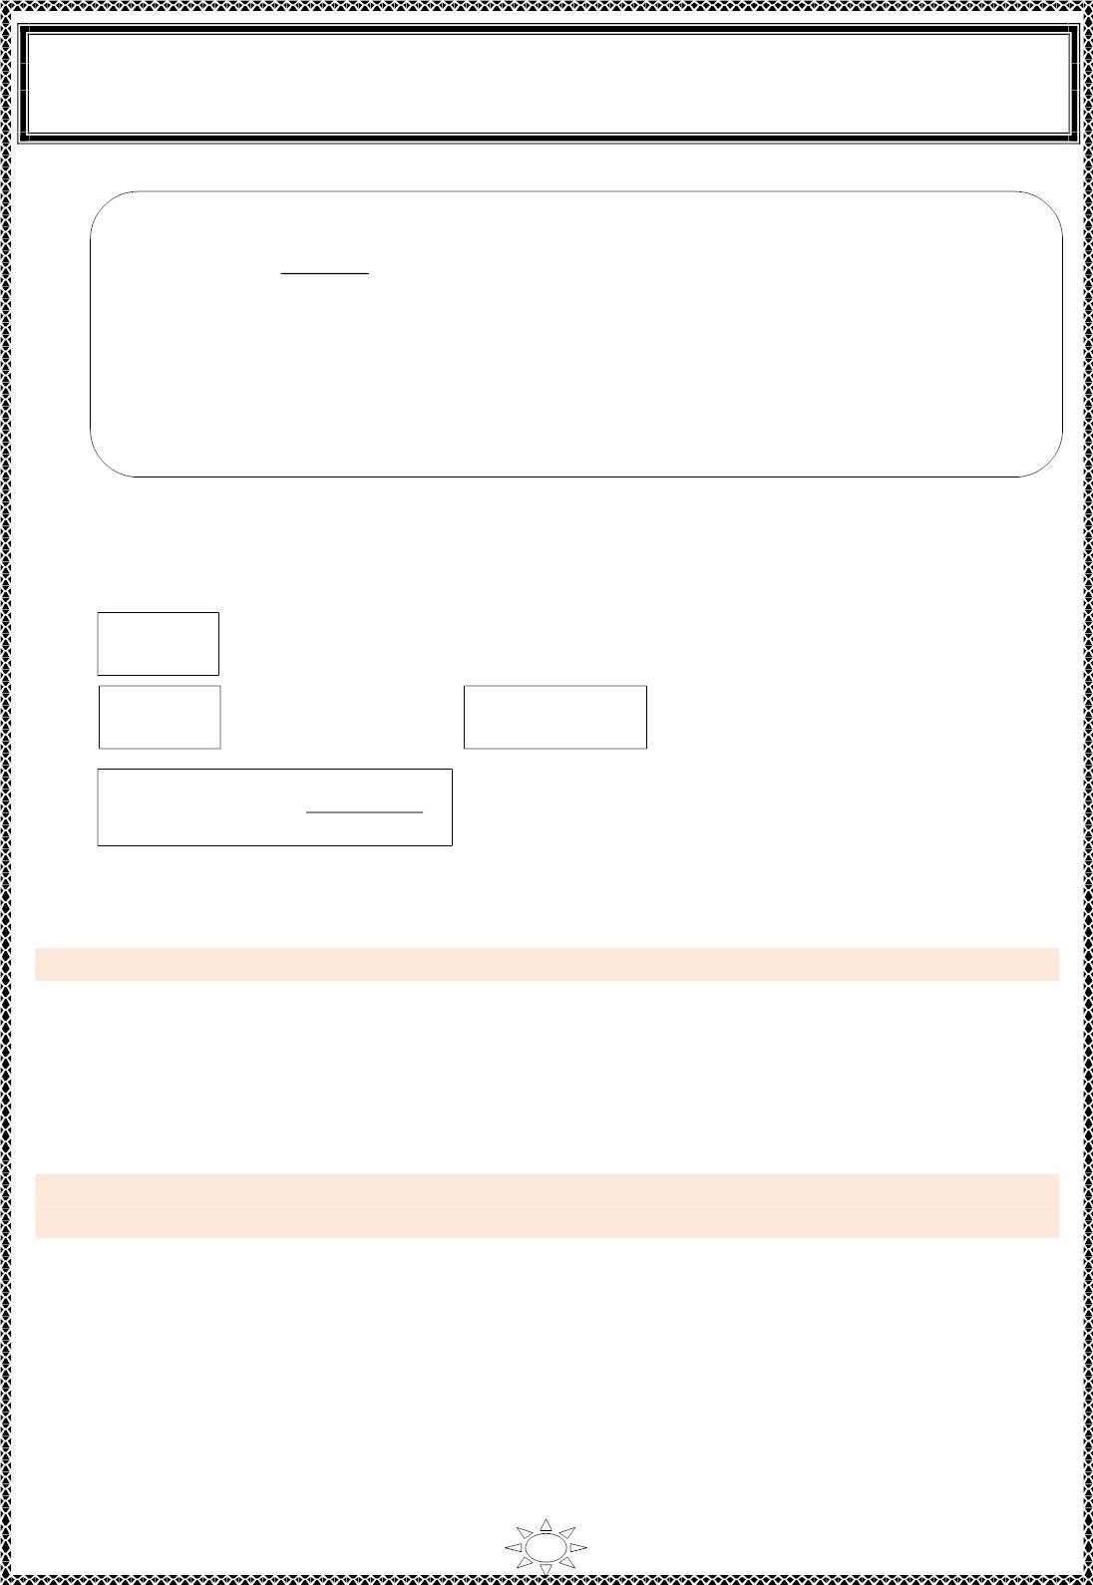
University of Diyala
Engineering College
Electronic Department
Electrical Engineering Fundamentals
1st Class
Asst., Lecturer : Wisam N. AL-Obaidi
Year (2013-2014)
Note:-
• 1 watt =
1joule
second
• 1 horse power (h.p.) = 746 watt
• Nega t ive power means the e le ment gives energy to network (such as sources).
• Pos it ive power means the element absorbs energy from network (such as
resistors).
7- Energy (W) :- It is quantity represents the product of power (P) & the period (t).
W =P.t
[watt.second
Or
or w.s
or joule]
푡
2
W = Q.V
W = 푃. 푑푡
Trail Version
Trail Version
Trail Version
Trail Version
Trail Version
Trail Version
Trail Version
Trail Version
Trail Version
Trail Version
Trail Version
Trail Version
Trail Version
푡
1
Energy [kW.h] =
Pꢀwꢁ×t[s]
1000
Example 2:How much energy does a 100w electr ic b ulb c ons umes in 2 hours?
Solution:
W = P.t = 100 × 2 = 200 w.h
Or
W = P.t = 100 × (2 × 60 ×60) = 720000 J = 720 KJ
Example 3: Determine the energy expended in moving a charge of 50 μC through a
potential d ifference of 6V.
Solution:
⁻⁶ ×
-6
W =Q.V = (50 × 10 ) 6 = 300 10 J = 300 μ J
×
5

Slide 6
Trail Version
Trail Version
Trail Version
Trail Version
Trail Version
Trail Version
Trail Version
Trail Version
Trail Version
Trail Version
Trail Version
Trail Version
Trail Version

Slide 7
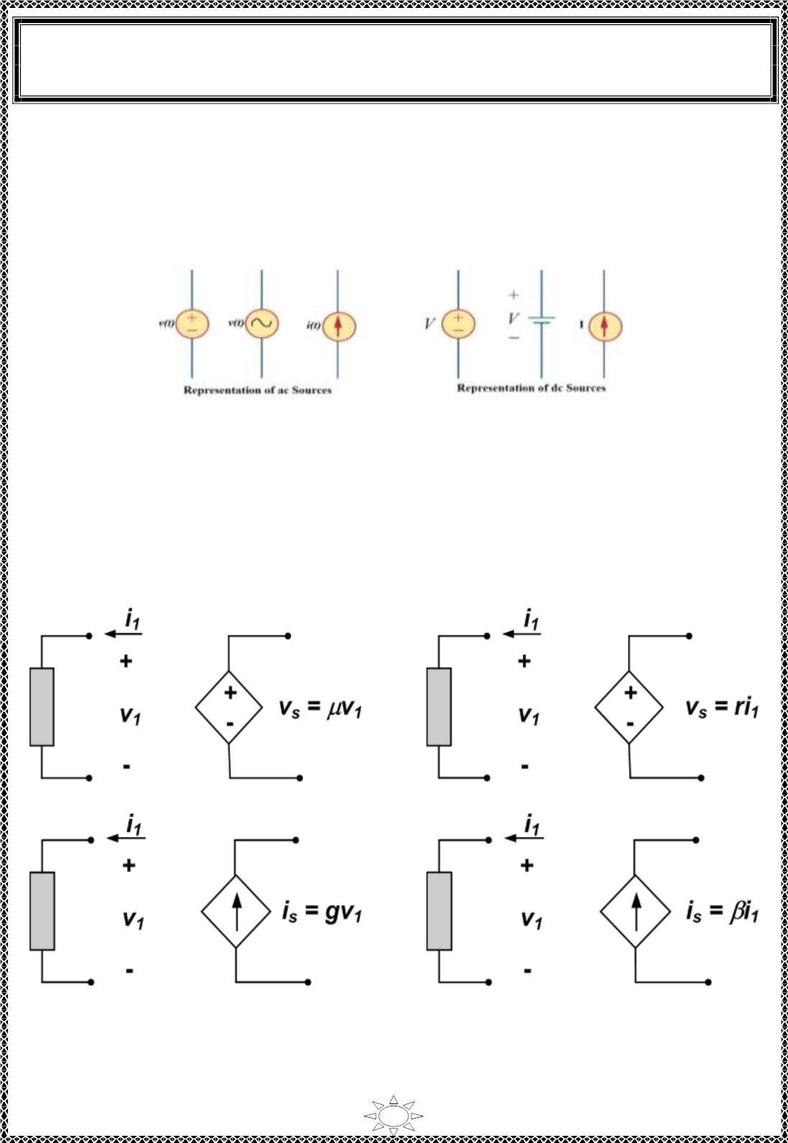
University of Diyala
Engineering College
Electronic Department
Electrical Engineering Fundamentals
1st Class
Asst., Lecturer : Wisam N. AL-Obaidi
Year (2013-2014)
Sources: sources (weather voltage or current sources) can be d ivid ed into two types,
(i) Independent Sources. (ii) Dependent Sources.
(i)Independent Source, is an active element that provides a specified voltage or current
that is completely independent of other c irc uit elements.
Figure (1.4): Representation of sources
(ii)Dependent (or controlled) Source, an active element in whic h the source quantity is
controlled by another voltage or current. It can be c las s ified as ,
1) A voltage-controlled voltage source (VCVS).
2) A current-controlled voltage source (CCVS ).
3) A voltage-controlled current source (VCCS).
4) A current-controlled current source (CCCS).
Trail Version
Trail Version
Trail Version
Trail Version
Trail Version
Trail Version
Trail Version
Trail Version
Trail Version
Trail Version
Trail Version
Trail Version
Trail Version
(a)VCVS, μ is voltage ga in (d imens ionless)
(b)CCVS, r is transresistance (Ω)
(c)VCCS, g is transconductance (siemens)
(d)CCCS, β is current ga in (d imensionless)
Figure (1.5): Representation of controlled sources
7

Slide 8
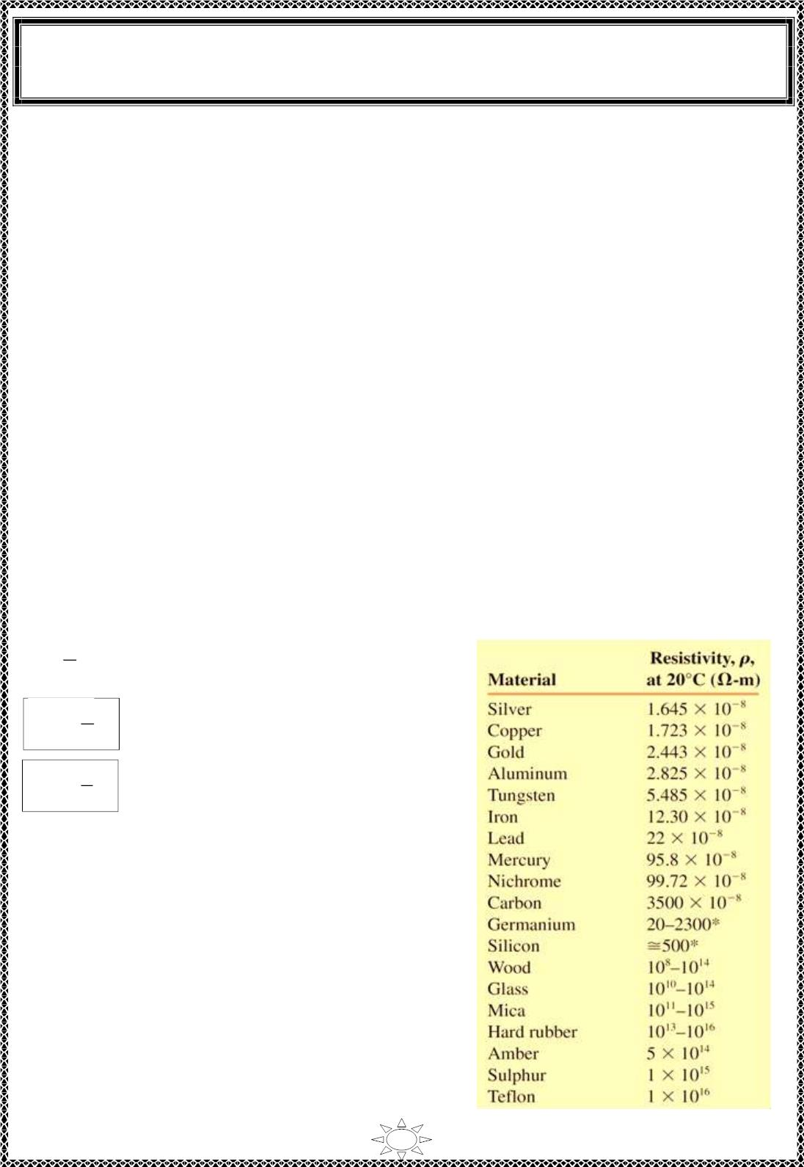
University of Diyala
Engineering College
Electronic Department
Electrical Engineering Fundamentals
1st Class
Asst., Lecturer : Wisam N. AL-Obaidi
Year (2013-2014)
Resistance
The flow of charge through any mat er ial encounters an opposing force similar in many
respects to mechanical fr ict ion. This oppos it ion, due to the collis ions between electrons
and between electrons and other atoms in the mat er ia l, which converts electrical energy
into another form of energy such as heat, is called the resistance of the mat er ia l. The unit
of measurement of resistance is the ohm, for which the symbol is (Ω) the capital Greek
letter omega.
The resistance of any material with a uniform cross-sectional area is determined by the
following four factors:
1. Material (it depends on the nature of the material).
2. Le ngth (it va r ies direct ly as it' s length).
3. Cross-sectional area (it varies inversely as the cross -section of the conductor).
4. Temperature (it depends on the temperature of the conductor).
As the temperature of most conduc tors increases, the increased mo tio n of the part ic les
within the molec ula r structure makes it inc re as ingly d ifficult for the ―free‖ carriers to pass
through, and the res istance level increases.
At a fixed temperature of 20°C (room temperature), the res istance is related to the other
three factors by
Trail Version
Trail Version
Trail Version
Trail Version
Trail Version
Trail Version
Trail Version
Trail Version
Trail Version
Trail Version
Trail Version
Trail Version
Trail Version
푙
Tab le (1.5): Resist ivit y of Materials
R α
(Ω)
(Ω)
퐴
푙
R = ρ
퐴
퐴
푙
ρ = 푅
(Ω.m)
Where ρ (Greek letter rho) is a characteristic of the
mater ial c a lled the specific res is ta nce or resistivity,
l is the length of the material, and A is the cross-
sectional area of the material.
8

Slide 9
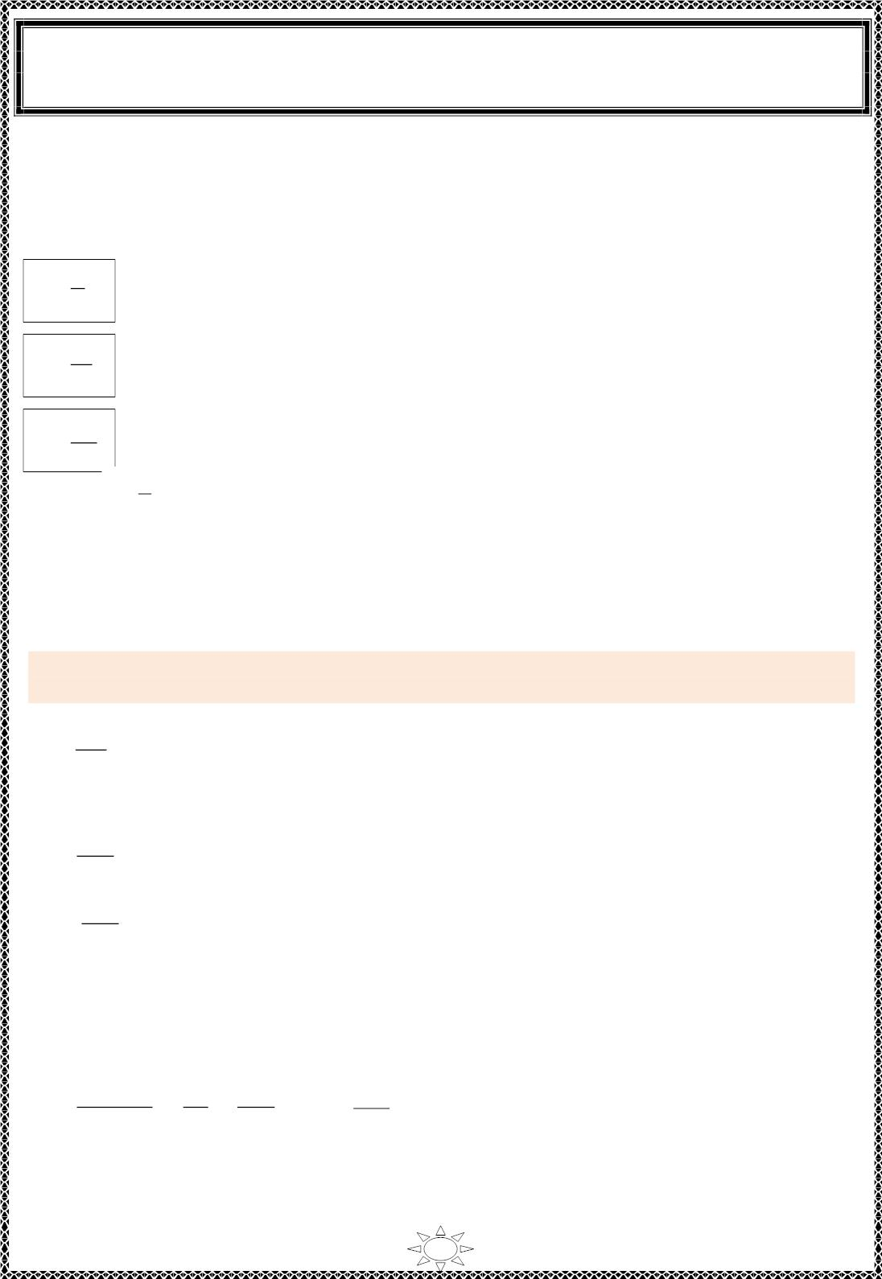
University of Diyala
Engineering College
Electronic Department
Electrical Engineering Fundamentals
1st Class
Asst., Lecturer : Wisam N. AL-Obaidi
Year (2013-2014)
Conductance
By finding the reciprocal of the resistance of a mat er ia l, we have a measure of how well
the material will conduct elec tric ity. The quantity is called conductance, has the symbol G,
and is measured in Siemens (S) or (moh). In equation form, conductance is,
1
G =
G =
G =
(s iemens , S)
R
퐴
휌푙
훾퐴
푙
(S)
1
Where 훾 =
( called c onduc tivity of mat er ial in [s/m])
휌
-6
A res istance of 1 MΩ is equivalent to a conductance of 10 S, and a res istance of 10 Ω is
equiva le nt to a conductance of 10⁻¹ S. The larger the conductance, therefore, the les s the
resistance and the greater the conductivit y.
Trail Version
Trail Version
Trail Version
Trail Version
Trail Version
Trail Version
Trail Version
Trail Version
Trail Version
Trail Version
Trail Version
Trail Version
Trail Version
Example 5: What is the relative increase or decrease in conductivity of a conductor if the
area is reduced by 30% and the length is increased by 40%? The res is tivit y is f ixed.
Solution:
A
G =
i
l_{i}
i ρ
i
with the subscript i for the init ial value. Using the subscript n for new value:
G =
A₁
…(1)
…(2)
1 ρ
^{l}1
1
G =
A₂
2 ρ
^{l}2
2
A₂ = 0.7 A₁
…(3)
…(4)
l₂ = 1.4 l₁
Substitute (3) & (4) in equation (2).
0.7A₁
0.7
1.4
A₁
A₁
G =
=
×
= 0.5 ×
= 0.5 G₁
2 ρ
×1.4l₁
ρ
l₁
1
ρ
l
1
1 1
9

Slide 10
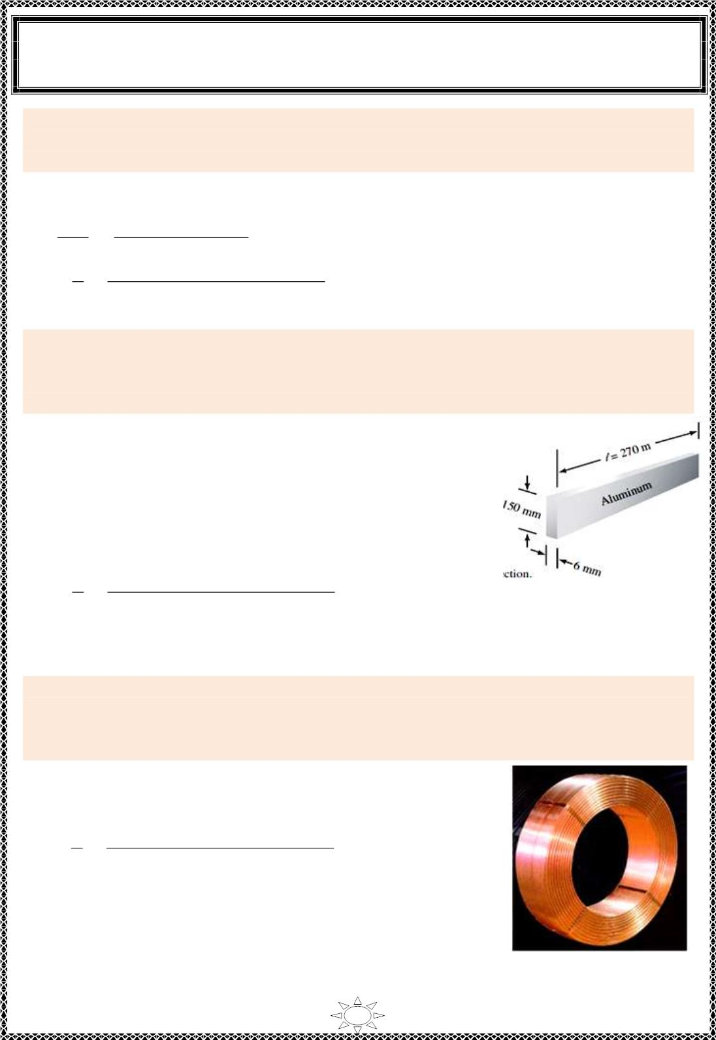
University of Diyala
Engineering College
Electronic Department
Electrical Engineering Fundamentals
1st Class
Asst., Lecturer : Wisam N. AL-Obaidi
Year (2013-2014)
Example 6: Most homes use solid copper wire having a diameter of 1.63 mm to provide
electrical distr ibut ion to outlets and light sockets. Determine the resistance of 75 meters of
a s olid copper wir e having the above diameter.
Solution:
We will first c alc u late the cross -sectional area of the wire.
2
−3 2
휋푑
휋×(1.63 × 10
)
A =
4
=
4
= 2.09 × 10^{−6 푚2}
푙
−8
R = ρ
(1.723 ×10 훺.푚) ×(75 푚)
= 0.619 Ω
퐴
=
2.09 ×10⁻⁶ 푚²
Example 7: Bus bars are bare s olid conductors (usually rectangular) used to carry large
currents wit hin buildings such as power generating stations, telephone exchanges, and
large factories. Given a p iece of aluminum bus bar as shown in Figure (1.6), determine the
resistance between the ends of this bar at a temperature of 20°C.
Solution:
The cross -s ectional area is
A = (150 mm)(6 mm)
= (0.15 m)(0.006 m)
= 0.0009 m²
= 9.00 × 10⁻⁴ m²
The resistance between the ends of the bus bar is determined as
Trail Version
Trail Version
Trail Version
Trail Version
Trail Version
Trail Version
Trail Version
Trail Version
Trail Version
Trail Version
Trail Version
Trail Version
Trail Version
푙
(2.825 ×10⁻⁸ 훺.푚) ×(270 푚)
R = ρ
=
9 ×10⁻⁴ 푚²
퐴
= 8.48 × 10 Ω
-3
Figure (1.6): Conductor with
= 8.48 mΩ
rectangular cross section
Example 8: A coil consists of 2000 turns of copper wire having a cross-sectional area of
0.8 mm². The mean length per turn is 80 cm and the res istivity of copper is 0.02 μΩ–m.
Find the resistance of the coil and power absorbed by the coil when connected across 110
V d.c. supply.
Solution:
Length of the c oil, l = 0.8 × 2000 = 1600 m ;
2
−6
2
A = 0.8 mm = 0.8 × 10 m .
푙
(0.02 ×10⁻⁶ 훺.푚) ×(1600 푚)
R = ρ
=
0.8 ×10⁻⁶ 푚²
퐴
= 40 Ω
2
2
Power absorbed = V / R = 110 /40 = 302.5 W
Figure (1.7)
10

